Slide 1
COSC 260
FLIGHT MANAGMENT
SYSTEM
By Mikias Tadele
07 December 2024

Slide 2



Overview
Program Overview
Dataset Overview
Classes
Binary Tree
Program Demo

Slide 3
Program Overview
The program prompts the user for Origin, Destination and Date they wish to travel on.
The programs uses the provided requirements to filter the dataset and search for relevant flights.
The program prints all the available flights that satisfy the requirement.

Slide 4
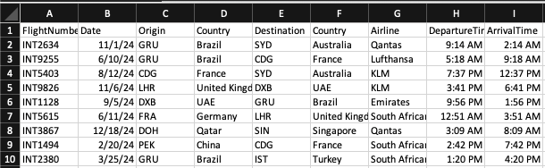
Dataset:
International Flights = 122,000 x 9

Slide 5
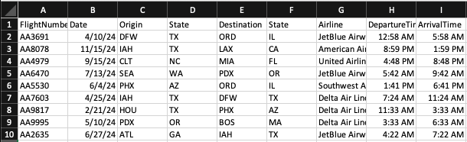
Dataset:
Domestic Flights: 114,000 X 9

Slide 6
Classes
Flight
International Flight
Domestic Flight
Flight Data
Binary Tree
Date Converter
Main Class

Slide 7
Flight Class
Stores Details: Flight number, date, origin, destination, etc...
Comparable: Changes Date to Float for the Binary tree
toString: Formats flight details.
Abstract getDetails(): Ensures subclass-specific behavior.
Base class for DomesticFlight and InternationalFlight.

Slide 8
International & Domestic Flight
Subclasses of Flight for specific flight types.
Use inherited attributes (flight details).
Override getDetails() for type-specific descriptions:
International: "International Flight: [details]"
Domestic: "Domestic Flight: [details]"
Polymorphism: Ensures behavior varies based on flight type.

Slide 9
FlightData Class
Reads CSV flight data.
Creates a list of Domestic or International flight objects.
Uses BufferedReader for file reading.
Processes lines.
Maps data to flight objects based on type.
Returns a list of flights.

Slide 10
Binary Search Tree
Manages flights using a generic binary tree structure.
Tree nodes store Flight objects.
Sorts Flight based on Date.
Node Class: Stores a value and links to left/right children.
Insertion: Adds nodes in sorted order using Comparable.
Inorder Traversal: Prints nodes in sorted order.
Search: Finds and prints flights matching a given date using recursive traversal.

Slide 11
Binary Search Tree
AA2345
5.08
2024-05-08
AA3691
4.14
AA7172
7.2
2024-04-14
2024-07-20
AA4979
1.08
AA5421
4.25
AA9278
6.24
AA1643
8.13
2024-08-13
2024-01-08
2024-04-25
2024-06-24
AA5423
11.17
2024-11-17

Slide 12
Date Converter
Changes String Date to Float
Date Calculation: Converted to a float.
Month: Represents the number before the decimal.
Day: Represents the number after the decimal.
Examples:
2024-05-15 = 5.15
2024-12-01 = 12.01

Slide 13
Program Demo

Slide 14
Thank You

